Slide 1
Magnetic Slider
Cankut Budak
Ahmet Berkay Uysal
Melih Kutay Yağdereli

Slide 2
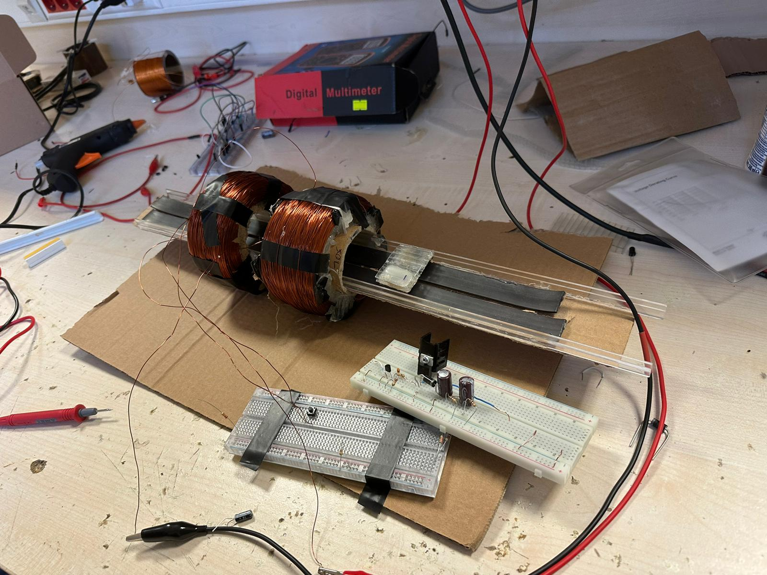
Magnetic Slider
The project aims to accelerate the levitating train object using the coils’ magnetic field.
To achieve levitating train object which will accelerate, magnetic tapes (under the train) and the Neodymium magnets (on top of the train) were used.
Figure 1: The Project Design

Slide 3
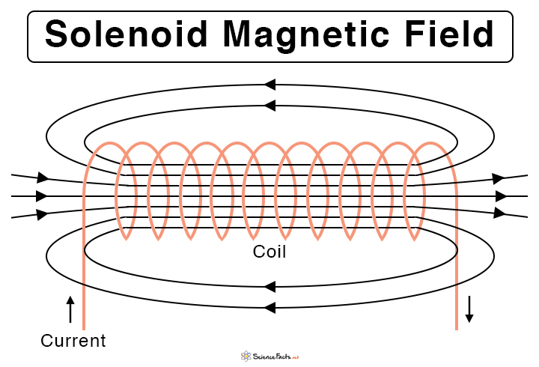
Structure of the Solenoids
f
In order to accelerate the levitating object, a magnetic field will be created by an electromagnet.
To have a working system, the coils should not create magnetic field all the time because magnetic field causes damped oscillation to the train inside the solenoid.
Figure 2: Illustration of the Magnetic Field of a Solenoid [1]

Slide 4
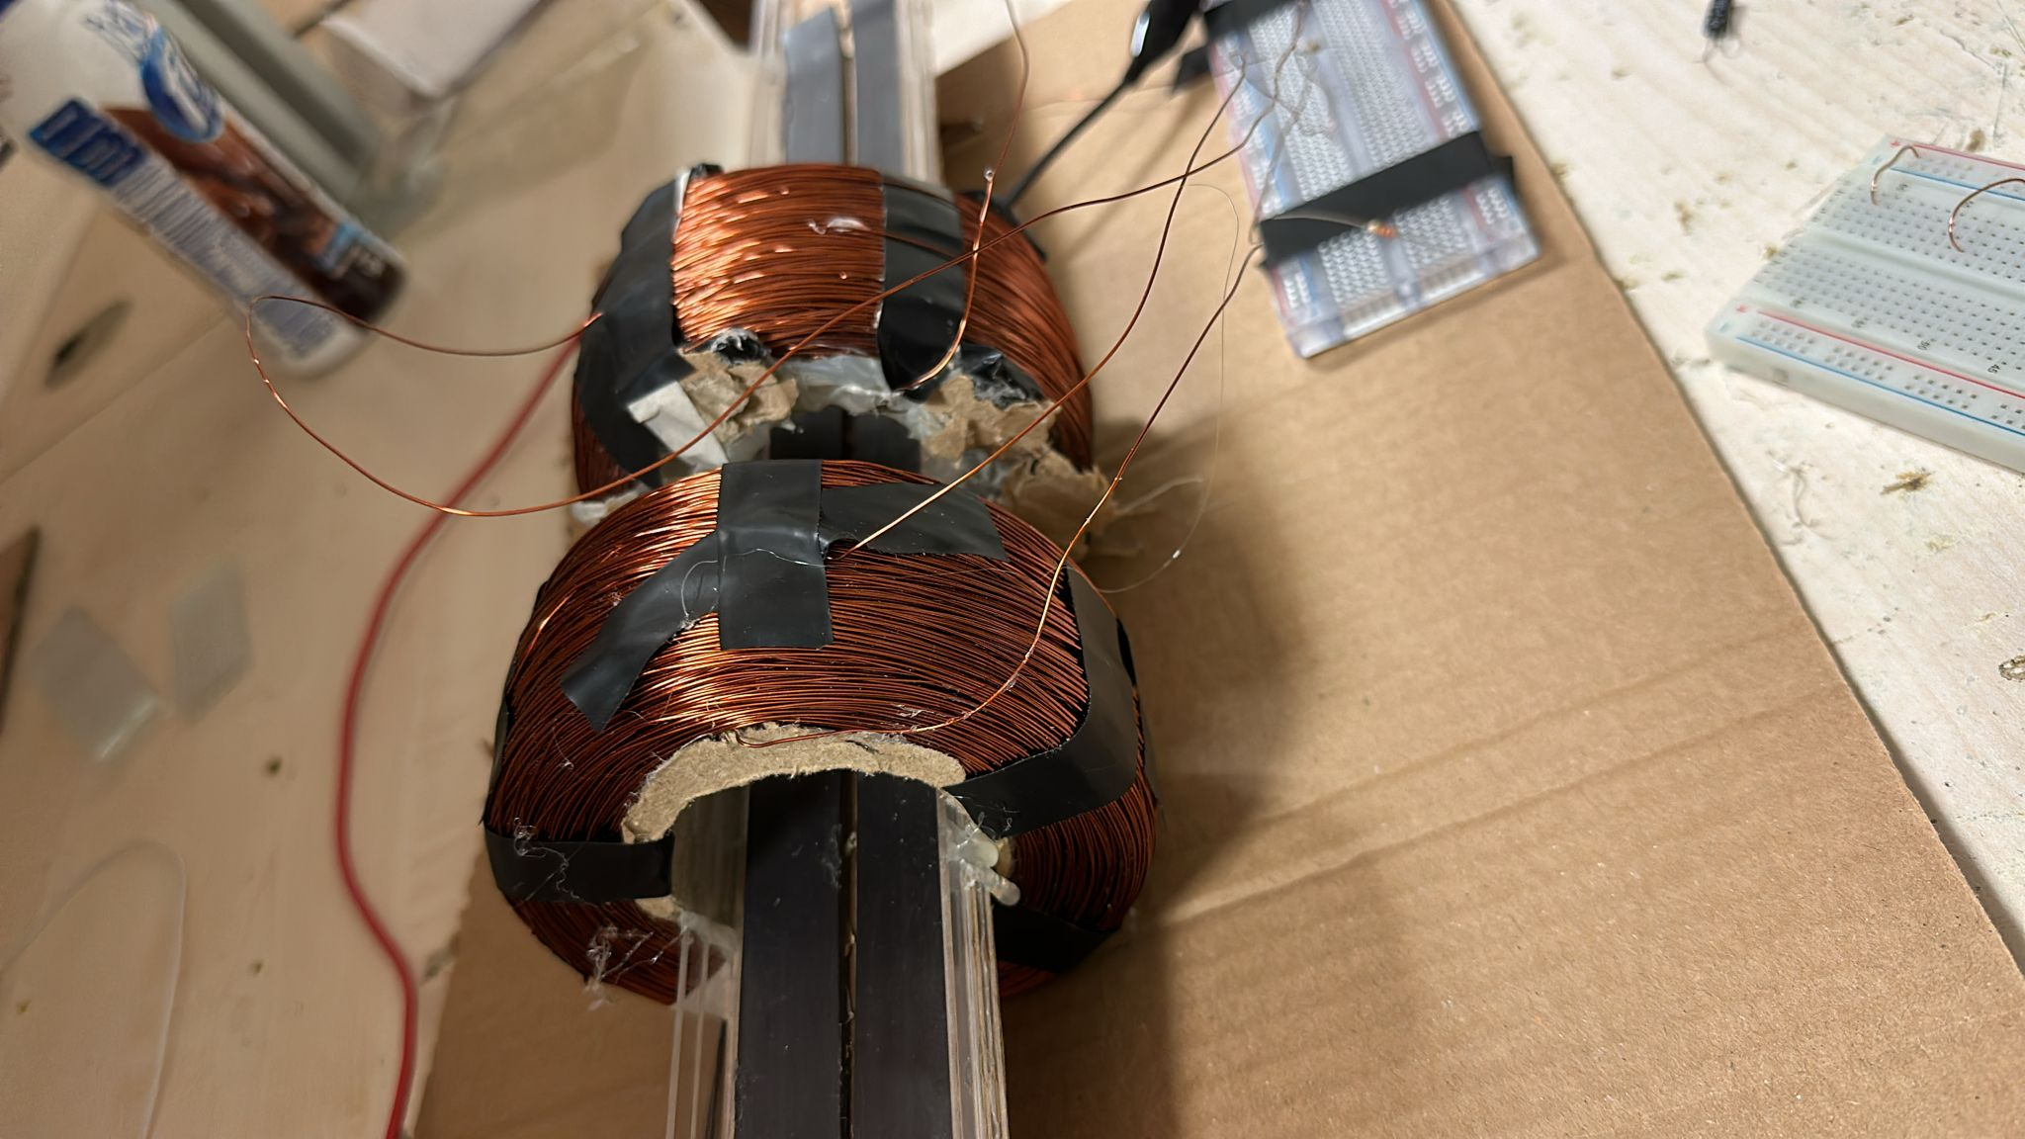
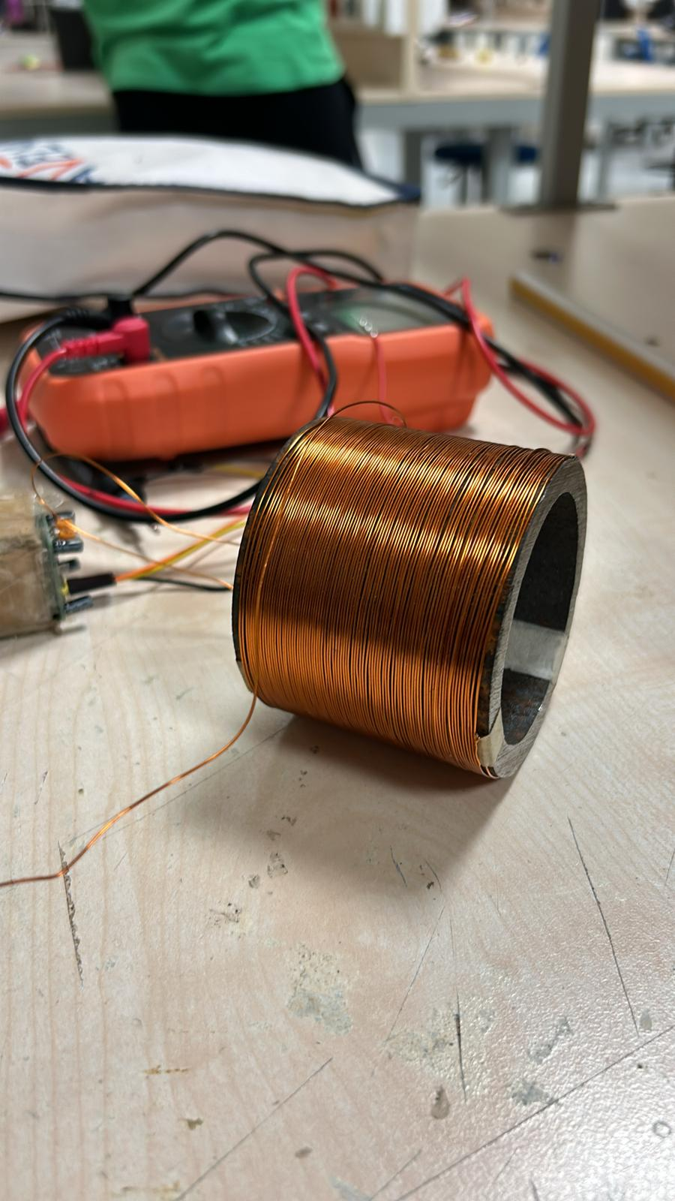
Implemented Solenoids
Figure 3: Two 1500 Turn Solenoids.
Figure 4: The Metal Core Solenoid

Slide 5
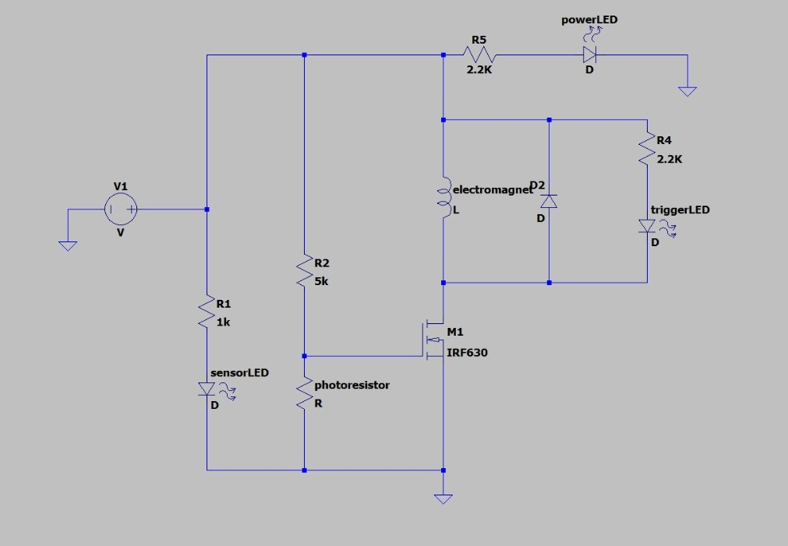
Circuit Design to Control the Current Duration on the Solenoid
In theory, to accelerate the object, when the levitating object arrives at the entrance of the solenoid, this should cause a prevention of current passage through the solenoid.
To implement this, IR led and photodiode is used respectively at the right and left side of the entrance of the solenoid. When the object arrives at the entrance of the solenoid, this will cause the current cut.
Figure 5: Circuit Schematic for Controlling the Current of the Solenoid

Slide 6
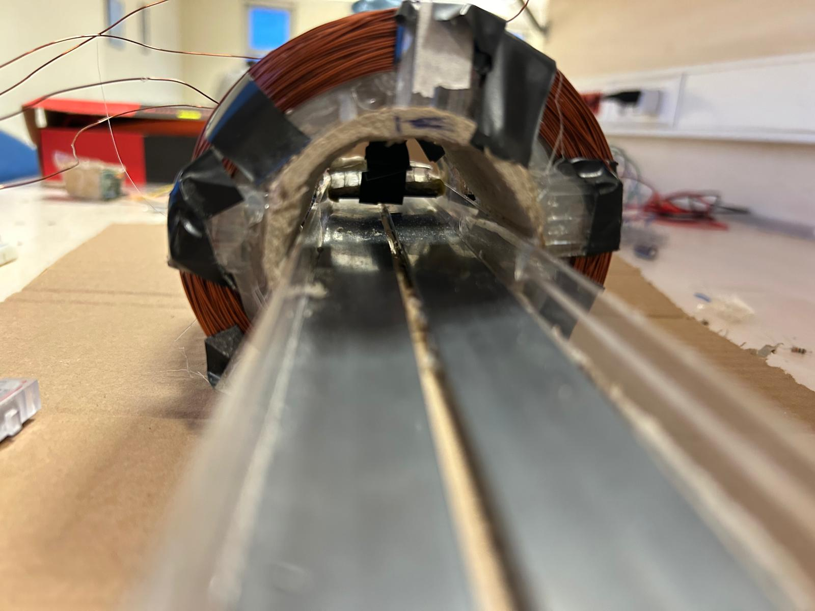
Levitating Train Object Design
Magnetic tapes are used in order to levitate the object. The tapes are applied both to track and train.
Plastic rulers are used to implement borders to the tracks.
N
S
N
S
Figure 6: the Levitating Train Object

Slide 7
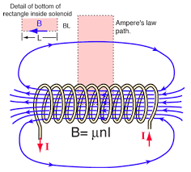
Calculation of the Magnetic Field Inside the Solenoid
From mathematical description magnetic field at the center of solenoid can be calculated from the equation below:
∮ 𝐵⃗ 𝐶 𝑑𝑙 ⃗⃗⃗ = 𝜇0𝑛𝐼𝐿 (𝐸𝑞. 1)
𝐵 = 𝜇0𝑛𝐼 (𝑇) (𝐸𝑞. 2)
This equation holds because a real solenoid has very small (𝐵⃗ ≅ 0) magnetic field outside compared to inside. The force applied on moving magnet by solenoid is given below:
𝐹 = ∇(𝜇 ∙ ⃗⃗⃗𝐵⃗ ) (𝑁) (𝐸𝑞. 3)
Figure 7: Magnetic Field Inside the Solenoid [2]

Slide 8
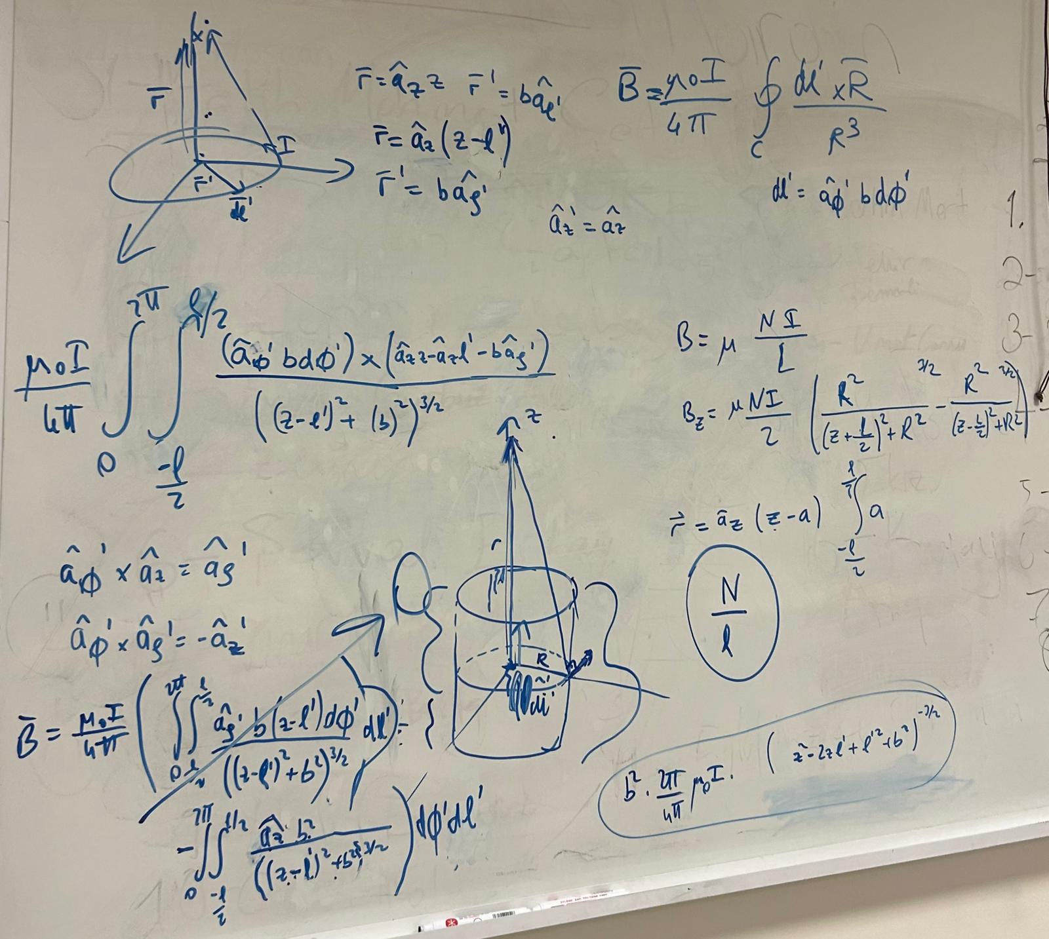
Approximation of the Magnetic Field at z axis (Outside the Solenoid)
With using Biot-Savart Law and ring example from the lecture notes, this law was tried to implement on solenoid.
It is with the help of approximating the solenoid as a “cylindrical shell which has rings on it”. (ignoring the small angle of the cable turns)
Figure 8: Trying to Calculate Magnetic Field Outside the Solenoid

Slide 9
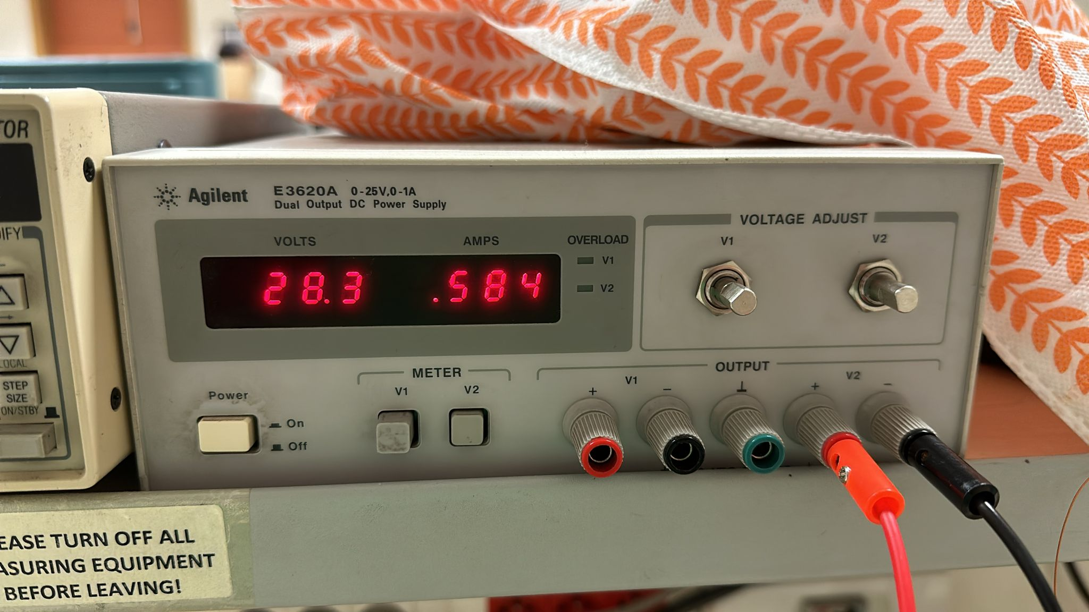
Safety
Due to high current and voltage value, the circuit causes some risks however, the overall system causes no harm to users.
Figure 9: The Current Value

Slide 10
Costs
Component | Cost
Iron pipe | 30 TL
Neodium magnet | 52 TL
Rulers | 120 TL
Carpenter | 30 TL
Cable chamber | 25 TL
Electrical tape | 12 TL
Cardboard | Free
Hotmelt glue stick | 77 TL
Gasoline: Bilkent to Ostim and Bauhaus | 166 TL
Total | 512 TL
Table 1: Costs of the Magnetic Slider Project

Slide 11
References
[1]Science Facts, “Solenoid Magnetic Field: Definition and Equation,” Science Facts, Sep. 06, 2021. https://www.sciencefacts.net/solenoid-magnetic-field.html
‌[2]R. Nave, “Solenoids as Magnetic Field Sources,” Gsu.edu, 2019. http://hyperphysics.phy-astr.gsu.edu/hbase/magnetic/solenoid.html‌

